Slide 1
Decision Tree
Notes:
Highlights: Introduce yourself and the session.
Key Takeaways: NA

Slide 2
Decision Tree
At the end of this session, you will be able to:
Evaluate the concept of decision trees and their usage for solving regression and classification problems.
Assess the concepts that make up the decision tree work, like Gini entropy, information gain, etc.
Notes:
Duration: 2 minutes
Highlights: Connect the discussion to the topics for the day. Provide an overview the concepts and tasks that will be covered in the session. Introduce the session outcomes.
Key Takeaways: What should learners be able to do at the end of this session?

Slide 3
Applications of Decision Tree
Customer Relationship Management: To classify customers’ online behavior into specific groups.
Fraudulent Statement Decisions: Auto-classification of banking transactions if they are fraudulent
Energy Consumption: How much energy will be consumed can be predicted in the next billing cycle.
Healthcare Management: In medical diagnosis, such as classifying patients as diabetic or not, or whether they have non-pneumonia or pneumonia, healthcare management is used.
Notes:
Duration: 10 minutes
Highlights:
Introduce the definition.
Identify the unique attributes.
Provide examples to elaborate the concept and non-examples to show the difference.
Use whiteboard if required.
Key Takeaways:
In what ways, learners can use the concept in real-life situations to provide solutions or solve problems.

Slide 4
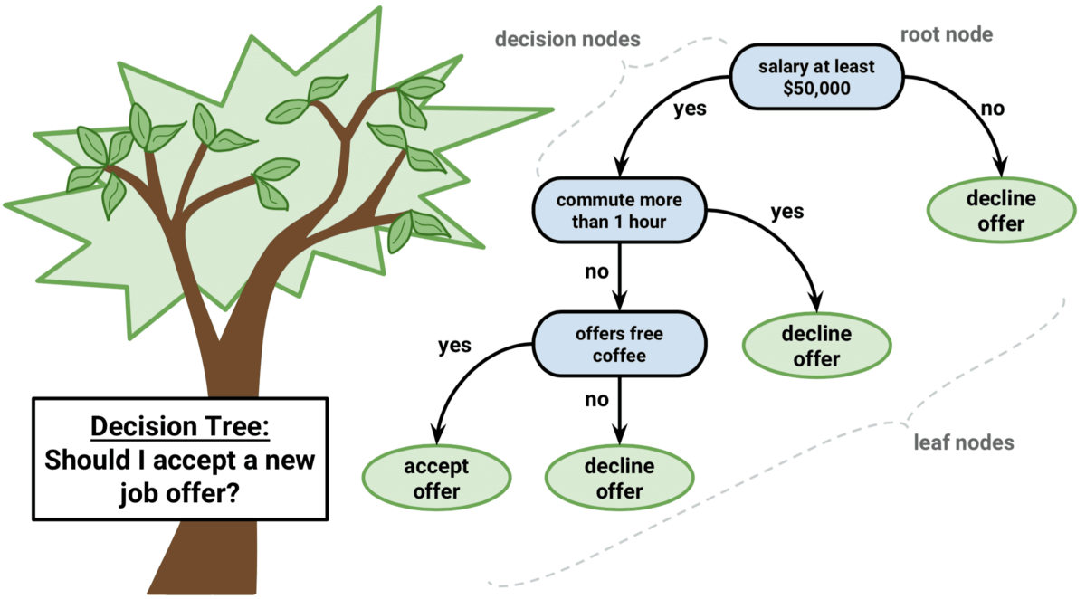
Decision Tree
A decision tree is a supervised learning algorithm in machine learning used to categorize or make predictions based on the previous set of rules.
Notes:
Duration: 10 minutes
Highlights:
Introduce the definition.
Identify the unique attributes.
Provide examples to elaborate the concept and non-examples to show the difference.
Use whiteboard if required.
Key Takeaways:
In what ways, learners can use the concept in real-life situations to provide solutions or solve problems.

Slide 5
Parametric vs. Non-parametric Algorithms
A decision tree is a non-parametric algorithm. Let’s understand what parametric and non-parametric algorithms are.
Parametric Algorithms
Non-parametric Algorithms
Parametric algorithms are based on a mathematical model defining a relationship between input and output variables.
Example of parametric algorithms
Linear regression
Logistic regression
Neural network
The non-Parametric algorithm tries to learn from the data itself and its patterns. They are computationally expensive.
Example of non-parametric algorithms
Decision tree
KNN
Support vector machine
Other ensemble models like (xgboost/adaboost/etc.)
Notes:
Duration: 10 minutes
Highlights:
Introduce the definition.
Identify the unique attributes.
Provide examples to elaborate the concept and non-examples to show the difference.
Use whiteboard if required.
Key Takeaways:
In what ways, learners can use the concept in real-life situations to provide solutions or solve problems.

Slide 6
Decision Tree
Decision tree provides a way to present an algorithm with conditional control statements.
Decision trees are more effective in handling nonlinear data sets effectively.
There are two decision tree types: Categorical variable and Continuous variable decision tree.
Notes:
Duration: 10 minutes
Highlights:
Introduce the definition.
Identify the unique attributes.
Provide examples to elaborate the concept and non-examples to show the difference.
Use whiteboard if required.
Key Takeaways:
In what ways, learners can use the concept in real-life situations to provide solutions or solve problems.

Slide 7
Types of Decision Tree
Categorical Variable Decision Tree
Continuous Variable Decision Tree
A categorical variable decision tree will have the target variable as a category. The categories can be Binary or Multiclass.
Example:
Yes/No, High/Medium/Low, Non-Pneumonia/Pneumonia
A continuous variable decision tree will have the target variable as Continuous.
Example:
Salary Prediction, Demand Forecasting, Stock Prediction.
Notes:
Duration: 10 minutes
Highlights:
Introduce the definition.
Identify the unique attributes.
Provide examples to elaborate the concept and non-examples to show the difference.
Use whiteboard if required.
Key Takeaways:
In what ways, learners can use the concept in real-life situations to provide solutions or solve problems.

Slide 8
CART
CART
Classification and Regression Tree
Decision Tree Classifier
Decision Tree Regressor
Notes:
Duration: 10 minutes
Highlights:
Introduce the definition.
Identify the unique attributes.
Provide examples to elaborate the concept and non-examples to show the difference.
Use whiteboard if required.
Key Takeaways:
In what ways, learners can use the concept in real-life situations to provide solutions or solve problems.

Slide 9
Structure of Tree
Before we learn about the decision tree algorithm, let’s first understand the tree structure.
A tree has nodes & branches.
Branches connect nodes.
There is a parent-child relationship between the nodes connected with a branch. (node c is the child of node a)
Depth of a node is defined as the number of branches from the node to the root node (depth of node g is 2).
A node that has no child is called a leaf node. (Nodes e, f, g, and d are leaf nodes)
A
Root Node
Branch
Decision Node
B
C
D
E
G
F
Leaf Node
Notes:
Duration: 10 minutes
Highlights:
Introduce the definition.
Identify the unique attributes.
Provide examples to elaborate the concept and non-examples to show the difference.
Use whiteboard if required.
Key Takeaways:
In what ways, learners can use the concept in real-life situations to provide solutions or solve problems.

Slide 10
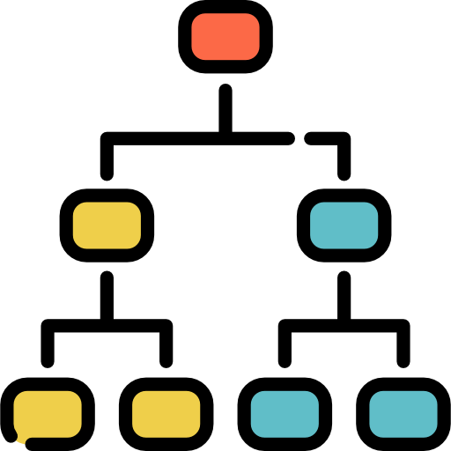
Make Decisions Using Tree
Logic behind the decision tree is to make decisions and continually split the dataset until Homogeneity.
For each question, we will add a node in the tree; the first node is called the root node.
Asking questions based on the feature splits the dataset resulting in a tree.
Notes:
Duration: 10 minutes
Highlights:
Introduce the definition.
Identify the unique attributes.
Provide examples to elaborate the concept and non-examples to show the difference.
Use whiteboard if required.
Key Takeaways:
In what ways, learners can use the concept in real-life situations to provide solutions or solve problems.

Slide 11


Terminologies
Entropy: Entropy can be defined as a measure of sub-split purity in machine learning. Entropy always lies between 0 and 1. The entropy of any partition can be calculated as follows:
Gini Impurity: Gini Impurity is somewhat like entropy in internal working. Both are used for building the tree using the best split. But there is quite a difference in computational methods.
Information Gain: Information gain tells us the best feature to split or the best feature to use as a root node for constructing a tree and then gradually creates an internal node and leaf node with each recursive split.
Notes:
Duration: 10 minutes
Highlights:
Introduce the definition.
Identify the unique attributes.
Provide examples to elaborate the concept and non-examples to show the difference.
Use whiteboard if required.
Key Takeaways:
In what ways, learners can use the concept in real-life situations to provide solutions or solve problems.

Slide 12
Let’s Implement a Decision Tree Classifier - 1
We will implement a decision tree using a small dataset, which has four features: loves popcorn, loves soda, age, and happy person, and remember the happy person is the target element for the dataset.
Loves Popcorn | Loves Soda | Age | Happy Person
Yes | Yes | 7 | No
yes | No | 12 | No
No | yes | 18 | yes
No | yes | 35 | yes
yes | yes | 38 | yes
yes | No | 50 | No
No | No | 83 | No
Step 1: Select the feature that will be the root node.
????
Notes:
Duration: 10 minutes
Highlights:
Introduce the definition.
Identify the unique attributes.
Provide examples to elaborate the concept and non-examples to show the difference.
Use whiteboard if required.
Key Takeaways:
In what ways, learners can use the concept in real-life situations to provide solutions or solve problems.

Slide 13
Let’s Implement a Decision Tree Classifier - 2
We will repeat the same process and fill all the leaf nodes recursively.
Loves Popcorn | Loves Soda | Age | Happy Person
Yes | Yes | 7 | No
yes | No | 12 | No
No | yes | 18 | yes
No | yes | 35 | yes
yes | yes | 38 | yes
yes | No | 50 | No
No | No | 83 | No
Select the feature that loves popcorn.
Loves Popcorn
Yes
No
Yes = 1
NO = 3
Yes = 2
No = 1
Happy Person
Happy Person
Notes:
Duration: 10 minutes
Highlights:
Introduce the definition.
Identify the unique attributes.
Provide examples to elaborate the concept and non-examples to show the difference.
Use whiteboard if required.
Key Takeaways:
In what ways, learners can use the concept in real-life situations to provide solutions or solve problems.

Slide 14
Let’s Implement a Decision Tree Classifier - 3
We will do the same thing for the Loves Soda we did for Loves Popcorn. And we will build a simple tree given below.
Loves Popcorn | Loves Soda | Age | Happy Person
Yes | Yes | 7 | No
yes | No | 12 | No
No | yes | 18 | yes
No | yes | 35 | yes
yes | yes | 38 | yes
yes | No | 50 | No
No | No | 83 | No
Select the feature that loves popcorn.
Loves Popcorn
Yes
No
Yes =
NO = 1
Yes =
No = 1
Happy Person
Happy Person
Notes:
Duration: 10 minutes
Highlights:
Introduce the definition.
Identify the unique attributes.
Provide examples to elaborate the concept and non-examples to show the difference.
Use whiteboard if required.
Key Takeaways:
In what ways, learners can use the concept in real-life situations to provide solutions or solve problems.

Slide 15
Let’s Implement a Decision Tree Classifier - 4
After we finish the rows, the simple tree below looks like when we have the Loves Soda attribute as a root node.
Loves Popcorn | Loves Soda | Age | Happy Person
Yes | Yes | 7 | No
yes | No | 12 | No
No | yes | 18 | yes
No | yes | 35 | yes
yes | yes | 38 | yes
yes | No | 50 | No
No | No | 83 | No
Now we will select the feature Loves Soda
Loves Soda
Yes
No
Yes = 3
NO = 1
Yes = 0
NO = 3
Happy Person
Happy Person
Notes:
Duration: 10 minutes
Highlights:
Introduce the definition.
Identify the unique attributes.
Provide examples to elaborate the concept and non-examples to show the difference.
Use whiteboard if required.
Key Takeaways:
In what ways, learners can use the concept in real-life situations to provide solutions or solve problems.

Slide 16
Let’s Implement a Decision Tree Classifier - 5
Loves Popcorn
Loves Soda
Yes
No
Yes
No
Yes = 1
NO = 3
Yes = 2
No = 1
Yes = 3
NO = 1
Yes = 0
NO = 3
Happy Person
Happy Person
Happy Person
Happy Person
1
2
3
4
Note: Both the tree where the root node is Loves Popcorn and Loves Soda. They need to classify better who will be the happy person and who will not.
Leaf Nodes one, two, and three have little purity and are heterogeneous, whereas Leaf Node four has the purity. We aim to remove heterogeneity and keep homogeneity.

Slide 17
Let’s Implement a Decision Tree Classifier - 6
From the previous comparison between two simple trees. The Loves Soda tree is better at predicting whether a person will be happy. The impurity is in only one leaf, but we can see impurity in the Loves popcorn tree in both leaves.
Loves Popcorn
Loves Soda
Yes
No
Yes
No
Yes = 1
NO = 3
Yes = 2
No = 1
Yes = 3
NO = 1
Yes = 0
NO = 3
Happy Person
Happy Person
Happy Person
Happy Person
Good News is that there is always a way to measure/quantify the impurity in the leaves. Some methods are Entropy and Gini Impurity. Methodically they are identical, but they do differ in formulas.
Notes:
Duration: 10 minutes
Highlights:
Introduce the definition.
Identify the unique attributes.
Provide examples to elaborate the concept and non-examples to show the difference.
Use whiteboard if required.
Key Takeaways:
In what ways, learners can use the concept in real-life situations to provide solutions or solve problems.

Slide 18
Let’s Implement a Decision Tree Classifier - 7
In this session, we will use Gini Impurity to understand how to calculate by formula. But we will also give the resources for Entropy as a post-read.
We will start calculating the Gini impurity for all the individual leaves for the Loves popcorn tree.
Loves Popcorn
Gini impurity of left leaf = 1-(probability of “yes”)²-(probability of “No”)²
= 1-(1/1+3)²-(3/1+3)²
= 0.375
Yes
No
Gini impurity of right leaf = 1-(probability of “yes”)²-(probability of “No”)²
= 1- (2/2+1)²-(1/1+2)
= 0.444
Yes = 1
NO = 3
Yes = 2
No = 1
Happy Person
Happy Person
Notes:
Duration: 10 minutes
Highlights:
Introduce the definition.
Identify the unique attributes.
Provide examples to elaborate the concept and non-examples to show the difference.
Use whiteboard if required.
Key Takeaways:
In what ways, learners can use the concept in real-life situations to provide solutions or solve problems.

Slide 19
Let’s Implement a Decision Tree Classifier - 8
Loves Popcorn
Yes
No
Yes = 1
NO = 3
Yes = 2
No = 1
Happy Person
Happy Person
Leaf on the left has 4 people in it
Leaf on the right has 3 people in it
As we can observe, leaves do not represent the same number of people. Thus, to know the information gained to decide whether this feature is best for the root node, we must compute the weighted average of the Gini impurities for the leaves.
Notes:
Duration: 10 minutes
Highlights:
Introduce the definition.
Identify the unique attributes.
Provide examples to elaborate the concept and non-examples to show the difference.
Use whiteboard if required.
Key Takeaways:
In what ways, learners can use the concept in real-life situations to provide solutions or solve problems.

Slide 20
Let’s Implement a Decision Tree Classifier - 9
Thus, the total Gini Impurity for all the leaves for:
Total Gini impurity = Weighted average for Gini Impurities for the leaves.
Total G.I. = Weighted gini avg for left leaf + weighted gini avg for right leaf
= (4/4+3) *0.375 + ( 3 / 4 + 3) *0.444
= 0.405
Loves Popcorn
Yes
No
Yes = 1
NO = 3
Yes = 2
No = 1
Happy Person
Happy Person
G.I.= 0.375
G.I.=0.444
Notes:
Duration: 10 minutes
Highlights:
Introduce the definition.
Identify the unique attributes.
Provide examples to elaborate the concept and non-examples to show the difference.
Use whiteboard if required.
Key Takeaways:
In what ways, learners can use the concept in real-life situations to provide solutions or solve problems.

Slide 21
Let’s Implement a Decision Tree Classifier - 10
We will use the same method to compute the weighted gini avg for the entire leaves for Love Soda.
Loves Soda
Total Gini impurity = Weighted average for Gini Impurities for the leaves.
Total G.I. = Weighted gini avg for left leaf + weighted gini avg for right leaf
= 0.214
Yes
No
Yes = 3
NO = 1
Yes = 0
NO = 3
Happy Person
Happy Person
Notes:
Duration: 10 minutes
Highlights:
Introduce the definition.
Identify the unique attributes.
Provide examples to elaborate the concept and non-examples to show the difference.
Use whiteboard if required.
Key Takeaways:
In what ways, learners can use the concept in real-life situations to provide solutions or solve problems.

Slide 22
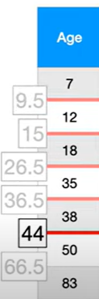
Let’s Implement a Decision Tree Classifier - 11
However, Age Contains numeric data, not just Yes/No values. Calculating the Gini Impurity is a little more involved. First, the values must be in ascending order, and then compute the average age for all the adjacent people.
Loves Popcorn | Loves Soda | Age | Happy Person
Yes | Yes | 7 | No
yes | No | 12 | No
No | yes | 18 | yes
No | yes | 35 | yes
yes | yes | 38 | yes
yes | No | 50 | No
No | No | 83 | No
Notes:
Duration: 10 minutes
Highlights:
Introduce the definition.
Identify the unique attributes.
Provide examples to elaborate the concept and non-examples to show the difference.
Use whiteboard if required.
Key Takeaways:
In what ways, learners can use the concept in real-life situations to provide solutions or solve problems.

Slide 23
Let’s Implement a Decision Tree Classifier - 12
We will calculate the Gini Impurity values for each average age. Let’s look at an example by selecting one of the average and see how we can compute gini impurity.
Loves Popcorn | Loves Soda | Age | Happy Person
Yes | Yes | 7 | No
yes | No | 12 | No
No | yes | 18 | yes
No | yes | 35 | yes
yes | yes | 38 | yes
yes | No | 50 | No
No | No | 83 | No
Average Age
7 +12 = 9.5
12+18 = 15
18+35 = 26.5
35+38 = 36.5
38+50 = 44
50+83 = 66.5
Age < 9.5
Yes
No
Yes= 0
No =1
Yes=3
No=3
Happy Person
Happy Person
Notes:
Duration: 10 minutes
Highlights:
Introduce the definition.
Identify the unique attributes.
Provide examples to elaborate the concept and non-examples to show the difference.
Use whiteboard if required.
Key Takeaways:
In what ways, learners can use the concept in real-life situations to provide solutions or solve problems.

Slide 24
Let’s Implement a Decision Tree Classifier - 13
So, the Gini Impurity would be:
GI for a left leaf node = 1- (probability of “yes”)² - (probability of “No”)²
=1-(0/0+1)²-(1/0+1)²
= 0
Age < 9.5
Yes
No
GI for a right leaf node =1-(probability of “yes”)² - (probability of“No”)² = 1-(3/3+3)²- (3/3+3)²
= 0.5
Yes = 0
No = 1
Yes = 3
No = 3
The weighted Gini Impurity for Age < 9.5 would be: (1/1+6)*0 + (6/1+6)*0.5 = 0.429
Notes:
Duration: 10 minutes
Highlights:
Introduce the definition.
Identify the unique attributes.
Provide examples to elaborate the concept and non-examples to show the difference.
Use whiteboard if required.
Key Takeaways:
In what ways, learners can use the concept in real-life situations to provide solutions or solve problems.

Slide 25
Let’s Implement a Decision Tree Classifier - 14
Likewise, we will calculate all other Gini impurities for all candidate values.
We can observe that low impurity for Avg Ages 15 and 44 has the common lower contaminant 0.343
In this case, we will choose the Avg Age of 15 for a split.
Average Age | Gini Impurity
9.5 | 0.429
15 | 0.343
26.5 | 0.476
36.5 | 0.476
44 | 0.343
66.5 | 0.429
Age < 15
Yes
No
No = 2
Yes = 0
No = 2
Yes = 3
Happy Person
Happy Person
Notes:
Duration: 10 minutes
Highlights:
Introduce the definition.
Identify the unique attributes.
Provide examples to elaborate the concept and non-examples to show the difference.
Use whiteboard if required.
Key Takeaways:
In what ways, learners can use the concept in real-life situations to provide solutions or solve problems.

Slide 26
Let’s Implement a Decision Tree Classifier - 15
Loves Popcorn | Loves Soda | Age | Happy Person
Yes | Yes | 7 | No
yes | No | 12 | No
No | yes | 18 | yes
No | yes | 35 | yes
yes | yes | 38 | yes
yes | No | 50 | No
No | No | 83 | No
There is a simple battle among loves popcorn, loves soda, and age who will be the tree’s root node.
Where a happy person is the target variable.
Notes:
Duration: 10 minutes
Highlights:
Introduce the definition.
Identify the unique attributes.
Provide examples to elaborate the concept and non-examples to show the difference.
Use whiteboard if required.
Key Takeaways:
In what ways, learners can use the concept in real-life situations to provide solutions or solve problems.

Slide 27
Let’s Implement a Decision Tree Classifier - 16
We will compare the weighted gini impurity for all the attributes from the selection method measures. Which point will be the root node?
Loves Popcorn | Loves Soda | Age | Happy Person
Yes | Yes | 7 | No
yes | No | 12 | No
No | yes | 18 | yes
No | yes | 35 | yes
yes | yes | 38 | yes
yes | No | 50 | No
No | No | 83 | No
Weighted gini impurities as follows :-
Gini impurity for Loves Popcorn = 0.405
Gini impurity for Age < 15 = 0.343
Gini impurity for Loves Soda =0.214
We know that leaves has lowest impurity for Loves Soda. Hence we will select the Loves Soda as the root node of the final tree.
Notes:
Duration: 10 minutes
Highlights:
Introduce the definition.
Identify the unique attributes.
Provide examples to elaborate the concept and non-examples to show the difference.
Use whiteboard if required.
Key Takeaways:
In what ways, learners can use the concept in real-life situations to provide solutions or solve problems.

Slide 28
Let’s Implement a Decision Tree Classifier - 17
We will put Love Soda in the top as a root node and then we will try to construct a tree.
Loves Popcorn | Loves Soda | Age | Happy Person
Yes | Yes | 7 | No
yes | No | 12 | No
No | yes | 18 | yes
No | yes | 35 | yes
yes | yes | 38 | yes
yes | No | 50 | No
No | No | 83 | No
Loves Soda
yes
No
Yes = 3
No = 1
Yes = 0
No = 3
Happy Person
Happy Person
The right leaf is impure
The left leaf is pure and Homogeneous
Notes:
Duration: 10 minutes
Highlights:
Introduce the definition.
Identify the unique attributes.
Provide examples to elaborate the concept and non-examples to show the difference.
Use whiteboard if required.
Key Takeaways:
In what ways, learners can use the concept in real-life situations to provide solutions or solve problems.

Slide 29
Let’s Implement a Decision Tree Classifier - 18
Loves Soda
As we can observe that in the Left Node there is impurity. To reduce the impurity we will have to go one more level or more set of questions to reduce impurity in the leaves.
Let's see if we can reduce the impurity by splitting the people that Loves Soda based on Loves Popcorn and Age.
Yes
No
Yes = 3
No = 1
Yes = 0
No = 3
Happy Person
Happy Person
Loves Popcorn
Age < ??
Notes:
Duration: 10 minutes
Highlights:
Introduce the definition.
Identify the unique attributes.
Provide examples to elaborate the concept and non-examples to show the difference.
Use whiteboard if required.
Key Takeaways:
In what ways, learners can use the concept in real-life situations to provide solutions or solve problems.

Slide 30
Let’s Implement a Decision Tree Classifier - 19
Loves Popcorn | Loves Soda | Age | Happy Person
Yes | Yes | 7 | No
yes | No | 12 | No
No | yes | 18 | yes
No | yes | 35 | yes
yes | yes | 38 | yes
yes | No | 50 | No
No | No | 83 | No
Loves Soda
yes
No
Yes = 3
No = 1
Yes = 3
No = 0
Happy
Person
Happy
Person
Loves Popcorn
vs
Age < ???
Yes = 1
No = 1
Yes = 2
No = 0
Total Gini Impurity = 0.25
Happy
Person
Happy
Person
Notes:
Duration: 10 minutes
Highlights:
Introduce the definition.
Identify the unique attributes.
Provide examples to elaborate the concept and non-examples to show the difference.
Use whiteboard if required.
Key Takeaways:
In what ways, learners can use the concept in real-life situations to provide solutions or solve problems.

Slide 31
Let’s Implement a Decision Tree Classifier - 20
Loves Popcorn | Loves Soda | Age | Happy Person
Yes | Yes | 7 | No
yes | No | 12 | No
No | yes | 18 | yes
No | yes | 35 | yes
yes | yes | 38 | yes
yes | No | 50 | No
No | No | 83 | No
We will calculate the average age for those people who Loves Soda and its yes.
7 + 18 = 12.5
18 + 35 = 26.5
35 + 38 = 36.5
Loves Soda
yes
No
Yes = 3
No = 1
Yes = 3
No = 0
Happy
Person
Happy
Person
Loves Popcorn
Age <???
Gini Impurity = 0.25
Notes:
Duration: 10 minutes
Highlights:
Introduce the definition.
Identify the unique attributes.
Provide examples to elaborate the concept and non-examples to show the difference.
Use whiteboard if required.
Key Takeaways:
In what ways, learners can use the concept in real-life situations to provide solutions or solve problems.

Slide 32
Let’s Implement a Decision Tree Classifier - 21
Over here we will take the Lowest impurity for Avg Age < 12.5 and will try to construct leaves for that node.
Loves Soda
Yes
No
Loves Popcorn | Loves Soda | Age | Happy Person
Yes | Yes | 7 | No
yes | No | 12 | No
No | yes | 18 | yes
No | yes | 35 | yes
yes | yes | 38 | yes
yes | No | 50 | No
No | No | 83 | No
Yes = 3
No = 1
Yes = 3
No = 0
Happy
Person
Happy
Person
Loves Popcorn
Age <12.5
Yes
No
Gini Impurity = 0.25
Yes = 0
No = 1
Yes = 3
No = 0
Happy
Person
Happy
Person
Notes:
Duration: 10 minutes
Highlights:
Introduce the definition.
Identify the unique attributes.
Provide examples to elaborate the concept and non-examples to show the difference.
Use whiteboard if required.
Key Takeaways:
In what ways, learners can use the concept in real-life situations to provide solutions or solve problems.

Slide 33
Let’s Implement a Decision Tree Classifier - 22
Now, we will finalize the Age as an internal node, person who loves soda and age < 12.5 can achieve impurity in the leaf nodes.
Loves Popcorn | Loves Soda | Age | Happy Person
Yes | Yes | 7 | No
yes | No | 12 | No
No | yes | 18 | yes
No | yes | 35 | yes
yes | yes | 38 | yes
yes | No | 50 | No
No | No | 83 | No
Loves Soda
Yes
No
Age <12.5
Yes = 0
No = 3
Yes
No
Yes = 0
No = 1
Yes = 3
No = 0
Notes:
Duration: 10 minutes
Highlights:
Introduce the definition.
Identify the unique attributes.
Provide examples to elaborate the concept and non-examples to show the difference.
Use whiteboard if required.
Key Takeaways:
In what ways, learners can use the concept in real-life situations to provide solutions or solve problems.

Slide 34
Let’s Implement a Decision Tree Classifier - 23
Once we are done with building the optimal tree, we will now assign the labels to the output leaf.
Loves Soda
Yes
No
We need to assign each leaf Happy person or Not Happy person as per the majority of yes/no in the leaf nodes.
Age <12.5
Yes = 0
No = 3
Yes
Not Happy person
No
Yes = 0
No = 1
Yes = 3
No = 0
Not Happy person
Happy person
Notes:
Duration: 10 minutes
Highlights:
Introduce the definition.
Identify the unique attributes.
Provide examples to elaborate the concept and non-examples to show the difference.
Use whiteboard if required.
Key Takeaways:
In what ways, learners can use the concept in real-life situations to provide solutions or solve problems.

Slide 35
Final Tree
Loves Soda
Yes
No
Age <12.5
Not Happy person
Yes
No
Not Happy person
Happy person
Notes:
Duration: 10 minutes
Highlights:
Introduce the definition.
Identify the unique attributes.
Provide examples to elaborate the concept and non-examples to show the difference.
Use whiteboard if required.
Key Takeaways:
In what ways, learners can use the concept in real-life situations to provide solutions or solve problems.

Slide 36
Prediction of New Data Point
The below table shows new data provided to decision tree - let's see how decision tree will work.
Loves Soda
Loves Popcorn | Loves Soda | Age | Happy Person
Yes | yes | 15 | ???
Yes
No
Age <12.5
Not Happy person
On this very information, if we want to predict whether the person will be happy/not.
Yes
No
Not Happy person
Happy person
Notes:
Duration: 10 minutes
Highlights:
Introduce the definition.
Identify the unique attributes.
Provide examples to elaborate the concept and non-examples to show the difference.
Use whiteboard if required.
Key Takeaways:
In what ways, learners can use the concept in real-life situations to provide solutions or solve problems.

Slide 37
Quiz Poll
1. What are the metrics to measure the impurities of a decision tree classifier?
Entropy
Gini index
Both I & II above
Standard deviation reduction.
2. Suppose a dataset consist of 4 features where 3 features are predictors, and another feature is Target variable. Now suppose if we have to select a feature as root node, then will it be an arbitrarily selection feature ?
Yes
No
3. What will be the node that we will be calling in a decision tree where there will be no further splits happening?
Root node
Terminal node
Decision node
Branch node
Notes:
Question 1: option C
Question 2: option b
Question 3: Option b

Slide 38
Quiz Poll
4. Assume in a dataset, we have 4 features out of those one feature is continuous variable. In selecting the root node, we have to compute the gini index for each variable. So when it comes to a constant variable, how will the gini impurity be calculated?
Taking account of the continuous variable.
Halving the records and then computing the gini impurity.
Taking 70%, 30% records of the cont. Variable and compute gini impurity.
Take the average of two points a consecutively and then compute gini impurity.
5. Let’s say you have built three decision trees on a small dataset dtree1 with max_depth 2 , dtree 2 with max_depth 5 and dtree 3 with max_depth 8. Which trees is more likely to overfit?
Dtree 1
Dtree 2
Dtree 3
None
Notes:
Question 4: option d
Question 5: Option c

Slide 39
Demo

Slide 40
Decision Tree: Regression

Slide 41
Decision Tree Regression Vs Linear Regression
Linear data & Nonlinear data
85
84
85
Marks
72
vs.
65
62.7
65
Marks
62
64
55
45
47
45
44
Hours spent
Hours spent
B
A
Notes:
Duration: 10 minutes
Highlights:
Introduce the definition.
Identify the unique attributes.
Provide examples to elaborate the concept and non-examples to show the difference.
Use whiteboard if required.
Key Takeaways:
In what ways, learners can use the concept in real-life situations to provide solutions or solve problems.

Slide 42
Prediction in Linear Data
85
If we want to predict the marks obtained when a student has spent around 6 hours.
This becomes easy to predict by a straight line because the nature of the data is linear, and the prediction is accurate.
72
Marks
65
62.7
55
45
Hours spent
A
Notes:
Duration: 10 minutes
Highlights:
Introduce the definition.
Identify the unique attributes.
Provide examples to elaborate the concept and non-examples to show the difference.
Use whiteboard if required.
Key Takeaways:
In what ways, learners can use the concept in real-life situations to provide solutions or solve problems.

Slide 43
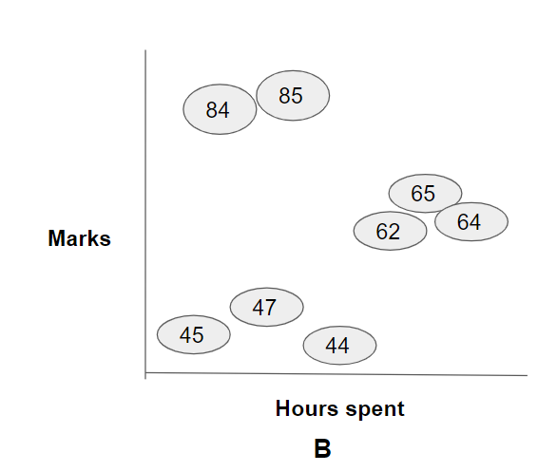
Prediction in Linear Data
Predicting with a straight line will be a big problem as data patterns are spread into clusters. If someone studies six hours a day will get average marks around 64 as per the straight line, it should be around 84.5.
So, in this scenario, making assumptions with a straight line will be a bad idea. Regression trees will be the best option to handle this shortfall.
Notes:
Duration: 10 minutes
Highlights:
Introduce the definition.
Identify the unique attributes.
Provide examples to elaborate the concept and non-examples to show the difference.
Use whiteboard if required.
Key Takeaways:
In what ways, learners can use the concept in real-life situations to provide solutions or solve problems.

Slide 44
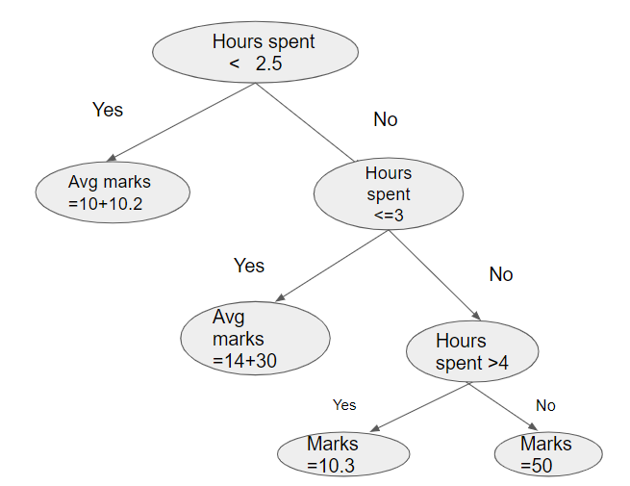
How Prediction Works in Decision Tree Regression - 1
Let’s say a student spends 2.7 hours studying their expected marks would be.
Based on the diagram, we can see that when hours spent is > two.5 and in the next level, if hours spent is <= 3, the output avg marks of ( 14+30) = 22.
Notes:
Duration: 10 minutes
Highlights:
Introduce the definition.
Identify the unique attributes.
Provide examples to elaborate the concept and non-examples to show the difference.
Use whiteboard if required.
Key Takeaways:
In what ways, learners can use the concept in real-life situations to provide solutions or solve problems.

Slide 45
How Prediction Works in Decision Tree Regression - 2
Hours spent < 2.5
Hours Spent | Marks Secured
2 | 10
2.1 | 10.2
2.5 | 14
3 | 30
4 | 50
6 | 10.3
Yes
No
Avg marks =10+10.2
Hours spent <=3
Yes
No
Avg marks =14+30
Hours spent >4
Yes
No
Marks =10.3
Marks=50
Notes:
Duration: 10 minutes
Highlights:
Introduce the definition.
Identify the unique attributes.
Provide examples to elaborate the concept and non-examples to show the difference.
Use whiteboard if required.
Key Takeaways:
In what ways, learners can use the concept in real-life situations to provide solutions or solve problems.

Slide 46
Decision Tree Regression Algorithm
Assume we have one predictor feature X and target variable Y.
First, it will average two samples from feature X. Then we will split the samples by the condition less than/more significant than the average, with some pieces left and right.
We will compute the average of all the samples for the left leaf node and all the examples for the right leaf node. We will calculate the sum of squared residuals combinedly for the left and right leaf nodes.
Step two to three is recursive until we get the least sum of squared residual for the individual split.
Once we get the split with the least squared residual sum, we will select that split as the root node.
Then, we will try to find the optimal split of all the left and right samples, keeping the first split as the root node to find the next decision node or further break.
We aim to find the leaf nodes with less variance between samples.
Notes:
Duration: 10 minutes
Highlights:
Introduce the definition.
Identify the unique attributes.
Provide examples to elaborate the concept and non-examples to show the difference.
Use whiteboard if required.
Key Takeaways:
In what ways, learners can use the concept in real-life situations to provide solutions or solve problems.

Slide 47
Quiz
1. Pick the scenario which is best for the Decision tree regression.
Mark secured by students wrt hours they spent studying.
Weight measure wrt hours they spend in the gym.
Customer retention on spending behavioral
House sale prediction
2. What is the measure/criteria to be used to construct a decision tree regression?
Gini Index
Entropy
Information gain
Standard deviation reduction
Notes:
Question 1: Option c
Question 2: Option d

Slide 48
Demo

Slide 49
Summary
In the session, you learned to:
Evaluate the concept of decision trees and their usage for solving regression and classification problems
Assess the concepts that make up the decision tree work, like Gini entropy, information gain, etc.​
Notes:
Duration: 10 minutes
Highlights:
Introduce the definition.
Identify the unique attributes.
Provide examples to elaborate the concept and non-examples to show the difference.
Use whiteboard if required.
Key Takeaways:
In what ways, learners can use the concept in real-life situations to provide solutions or solve problems.

